Slide 1
Covid-19 viz via cartograms
Johny Rufus

Slide 2
Motivation

Slide 3
Motivation
Impact of COVID-19, the coronavirus is severe
Important to study a number of factors - the spread of the disease, the causal factors, the impact on the economy
Data visualization plays a major rule
Our goal - create visualizations to better understand the timeline
In particular focus on cartograms - to better understand the spread of the disease in the United States
Time series visualizations
Time lapse videos

Slide 4
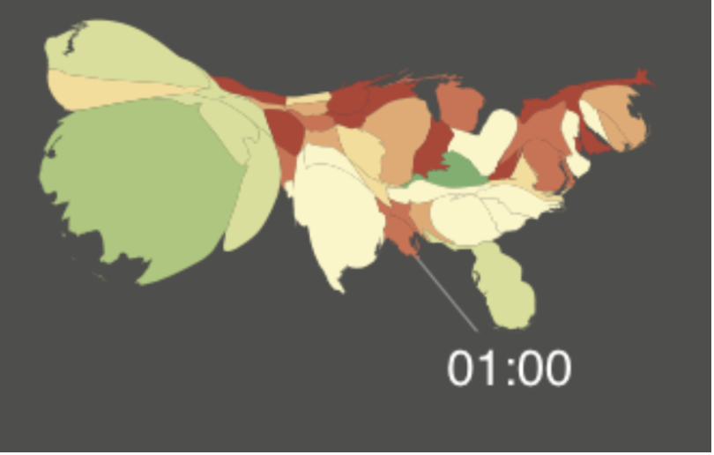
Motivation
Cartograms - effective tools for geo data
Very good at highlighting the variable of interest
Twitter mood visualization project from our Professor and his team.
Captures the changing mood of the people during various times of the day using the sentiment of the tweets.
Project the size of the states proportionate to the number of tweets, with the color representing the sentiment of the tweets.

Slide 5
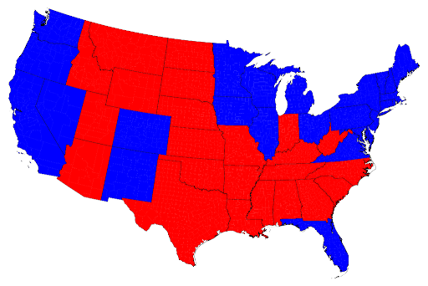
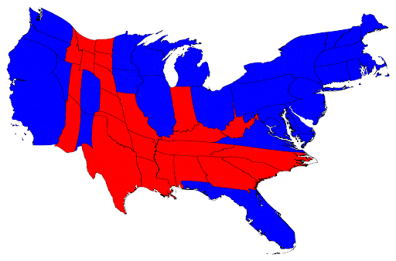
Motivation 2012 US Presidential election results: The importance of cartograms in effectively displaying the variable of interest can be very clearly understood from the work done by Newman and Gastner in their work on displaying the 2012 US Presidential election results.

Slide 6
Motivation
Goal for our project:
visualize confirmed cases and deaths in the US using choropleth maps
experiment with noncontiguous cartograms, contiguous cartograms
create visualizations and time lapsed animation videos - United States

Slide 7
Existing Work

Slide 8
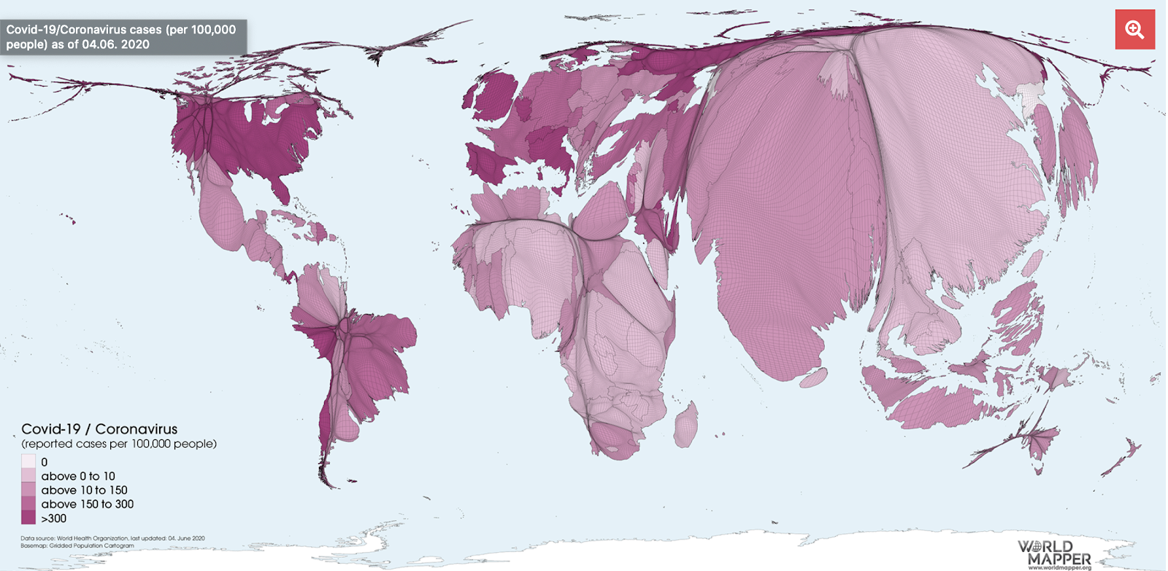
Existing Work
cartogram of the Covid-19 cases – worldmapper site
resizes the size of a country in proportion to its population
color scheme represents the number of reported cases per 100k people.

Slide 9
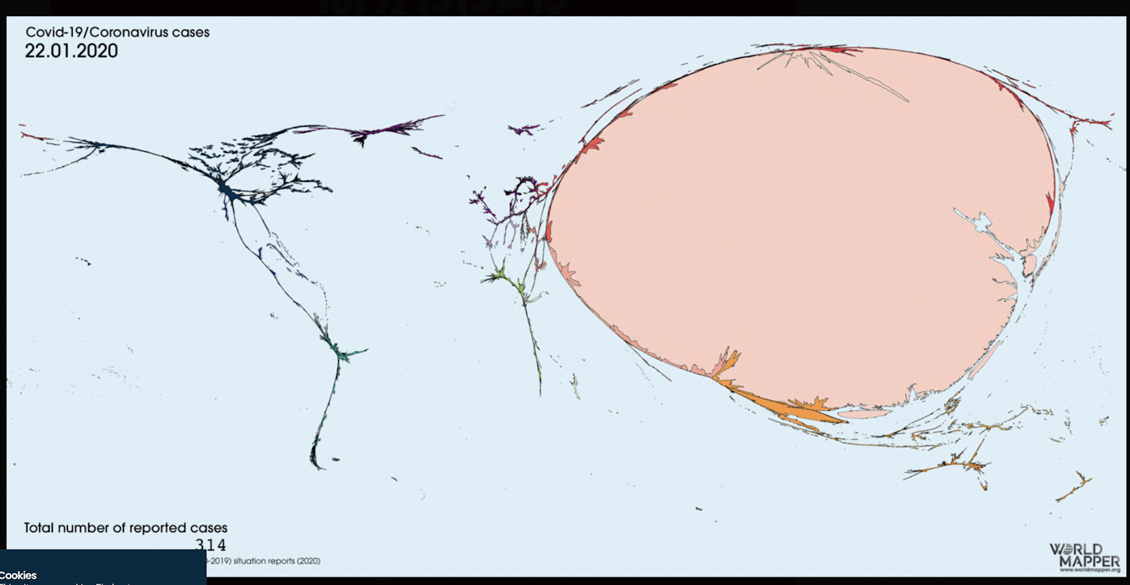
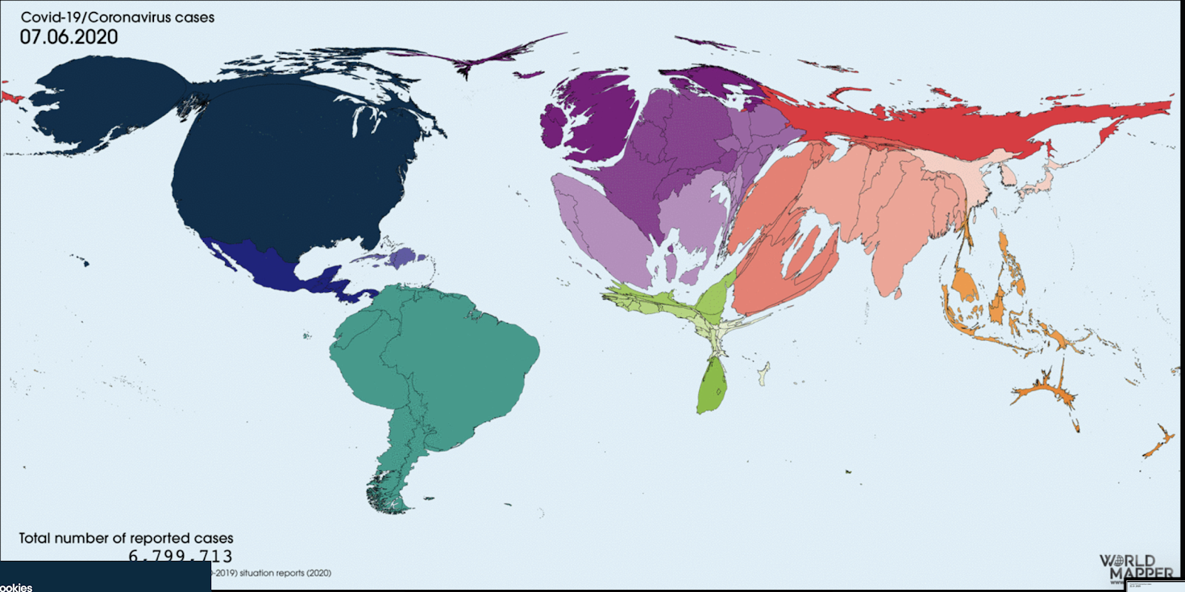
Existing Work
Time lapse video of the cartogram for the entire world
Resize the area of a region based on the number of cases
clear depiction of the flow of the infection

Slide 10
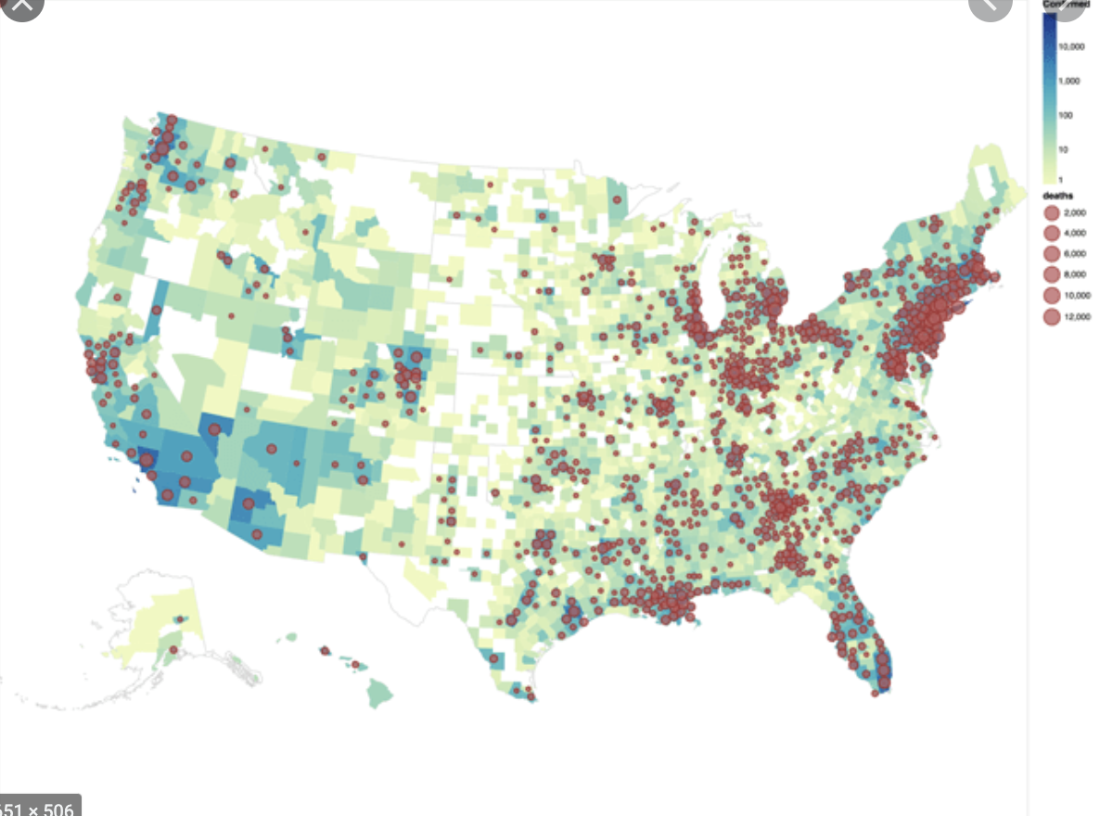
Existing Work
choropleth map – cases, deaths
intuitive compared to cartograms

Slide 11
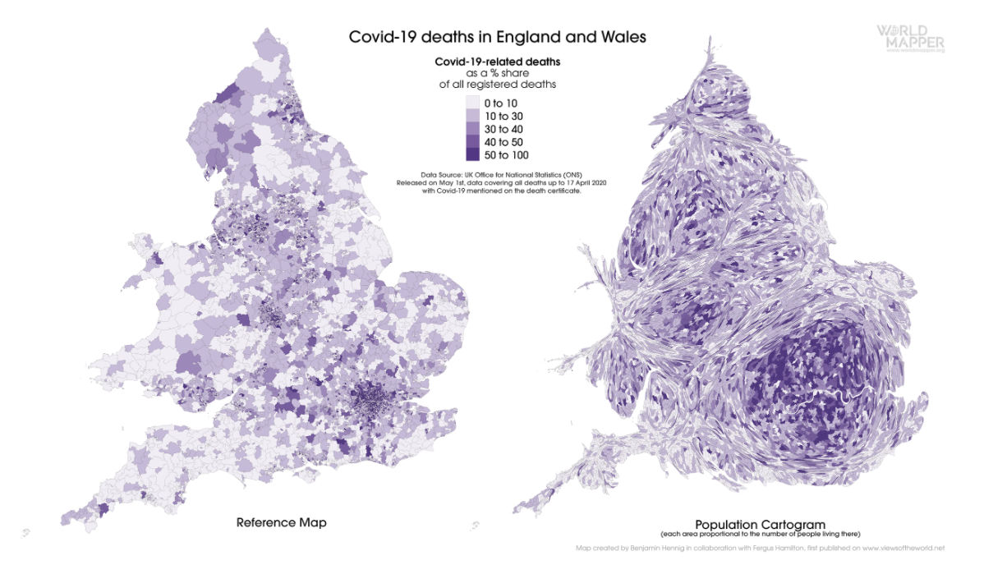
Existing Work
Viz from viewsoftheworld webpage
balance between the cartogram approach and the choropleth approach

Slide 12
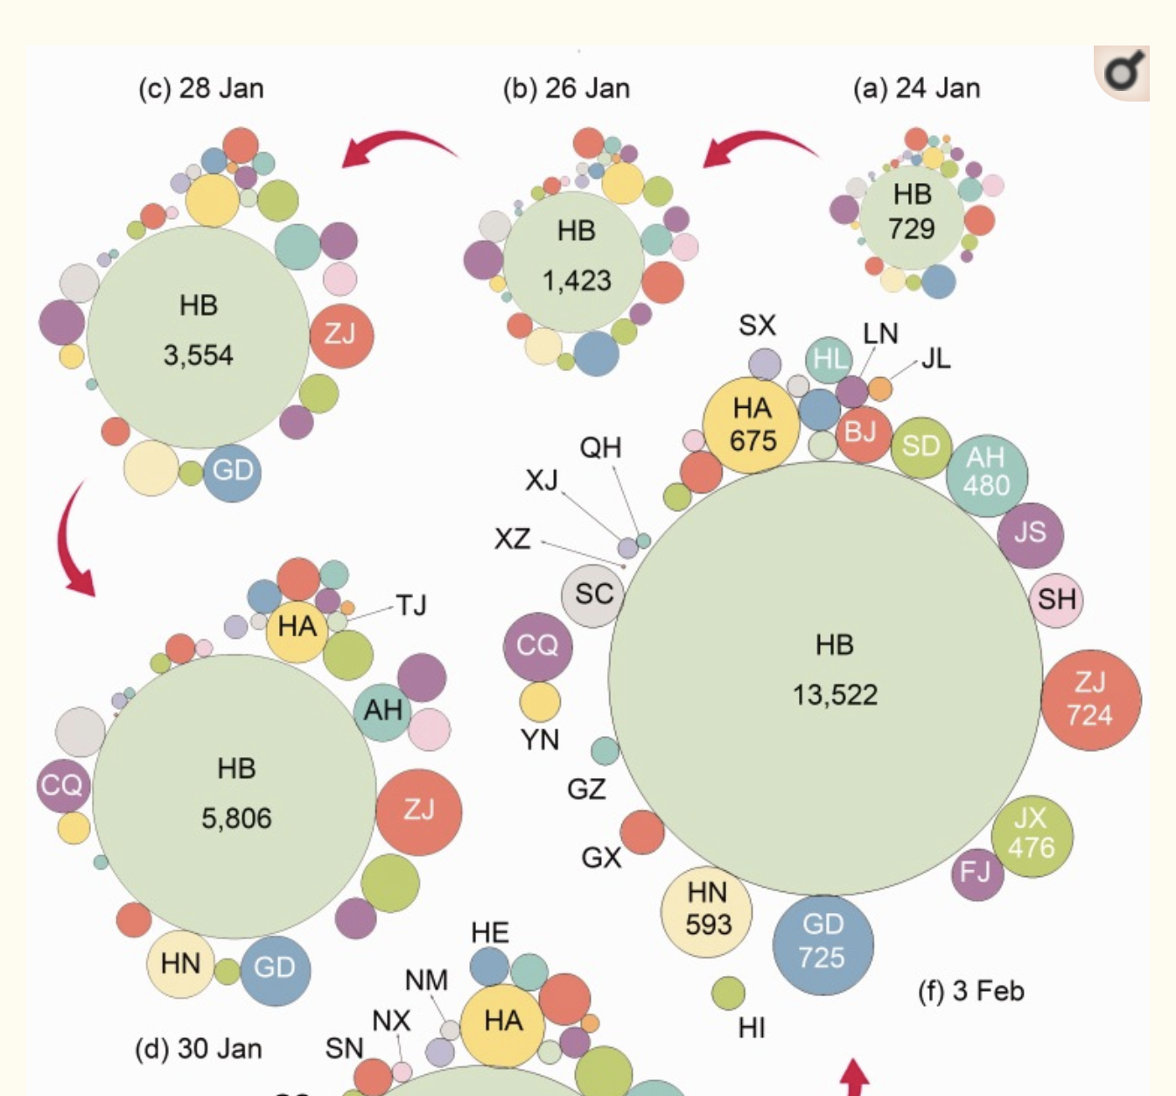
Existing Work
dorling cartogram
effective but sacrifices the geographical shape

Slide 13
Contribution

Slide 14
Contribution
existing viz using cartograms - entire world
our goal is
time lapse video of the cartograms for the US region
number of cases and deaths
completely new visualization of the covid-19 pandemic.
contributed to the underlying cartogram open source repository - couple of fixes and features.

Slide 15
Data

Slide 16
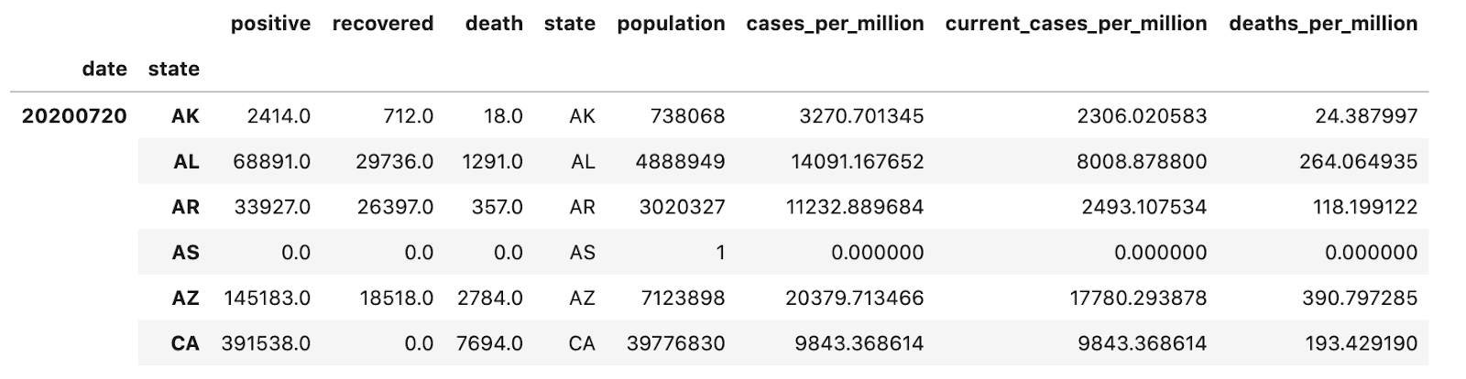
Data
data from The New York Times Covid-19, tracking project
updated daily - first case in January - current at state level.
cleaned and transformed dataframe - positive cases, recovered cases, deaths, total population , cases/current_cases/deaths per million.

Slide 17
Methods and Results

Slide 18
Methods & Results: Choropleth time series
series of choropleth maps - timeline of the coronavirus spread.
small multiples - each frame in the visualization captures the number of current cases - choropleth heat maps - starting of the month.
first set - the time series using number of positive confirmed cases
second set - time series using current cases per million
third set – using deaths per million.
nice story of the timeline is captured as we will see in the next few slides

Slide 19
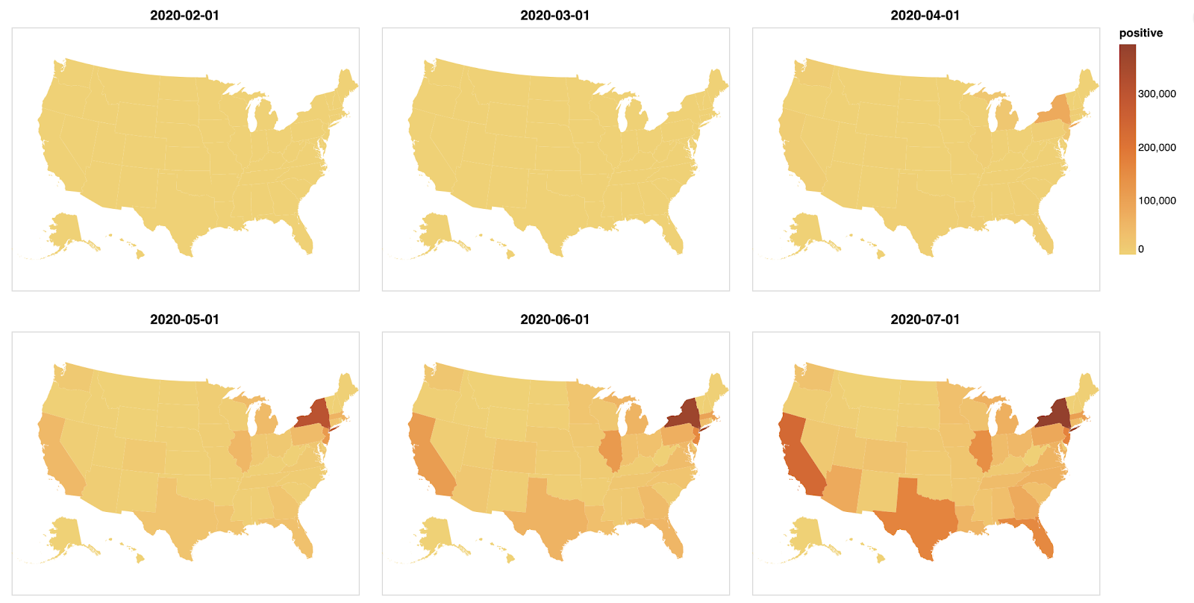
Photo caption can be entered here to the desired length. Tell people about the historical significance of the image or point out relevant pieces of information.
Photo credit here

Slide 20
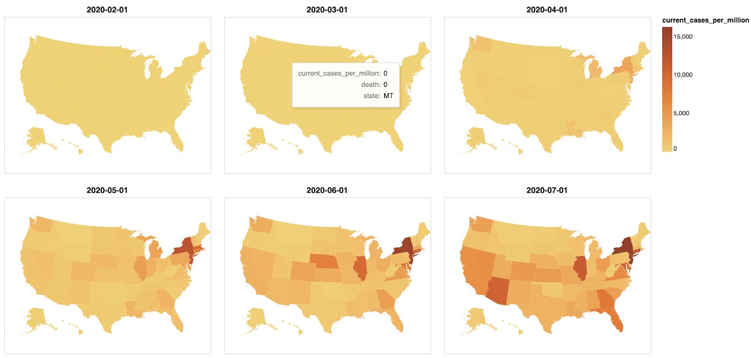
Photo caption can be entered here to the desired length. Tell people about the historical significance of the image or point out relevant pieces of information.
Photo credit here

Slide 21
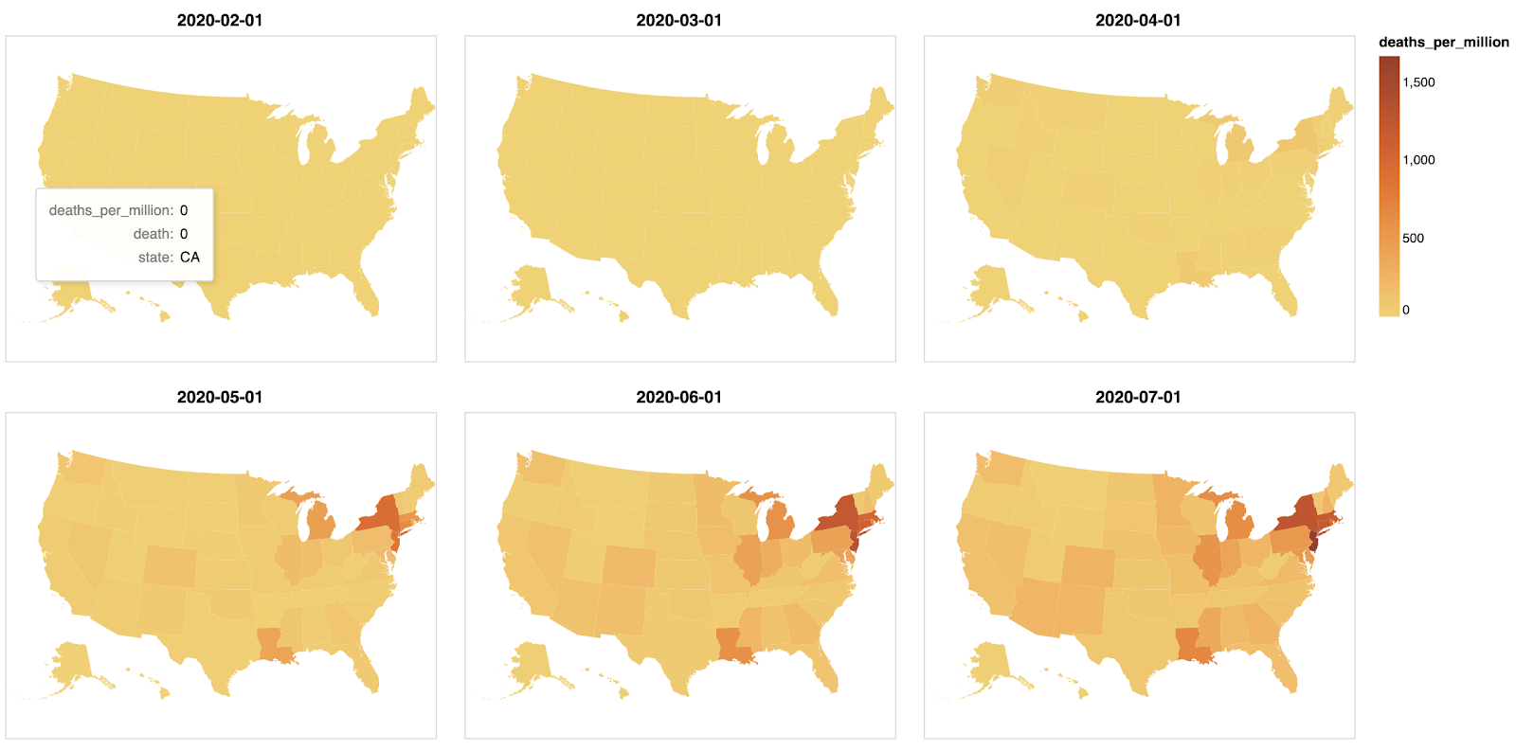
Photo caption can be entered here to the desired length. Tell people about the historical significance of the image or point out relevant pieces of information.
Photo credit here

Slide 22
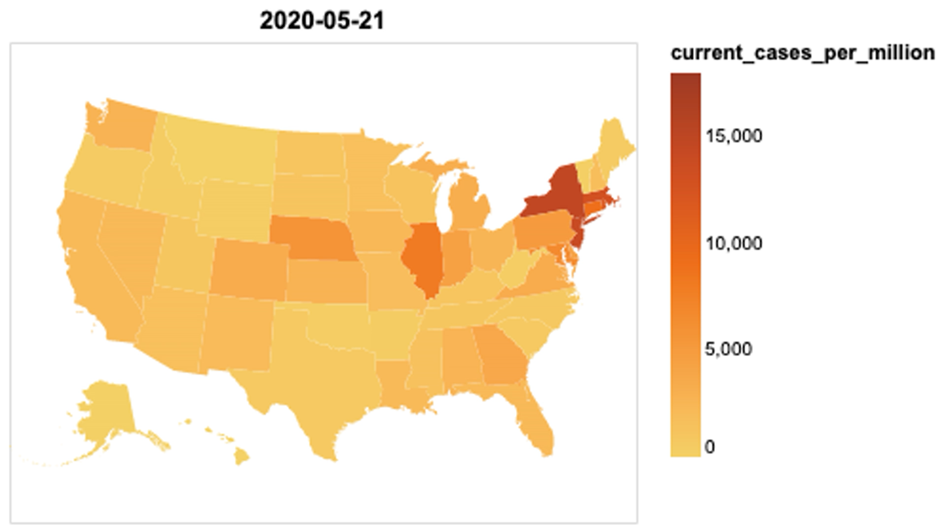

Slide 23
Methods & Results: Noncontiguous Cartogram
maintains the shape of the regions - emphasizes variable of interest - distorted topology and object centroids.
features are not connected, but enlarge or shrink based on the variable of interest
pretty neat time lapsed video - portray both the cases and deaths evolution in a nice time series.
the way the states change size and colors is amazing to watch.

Slide 24
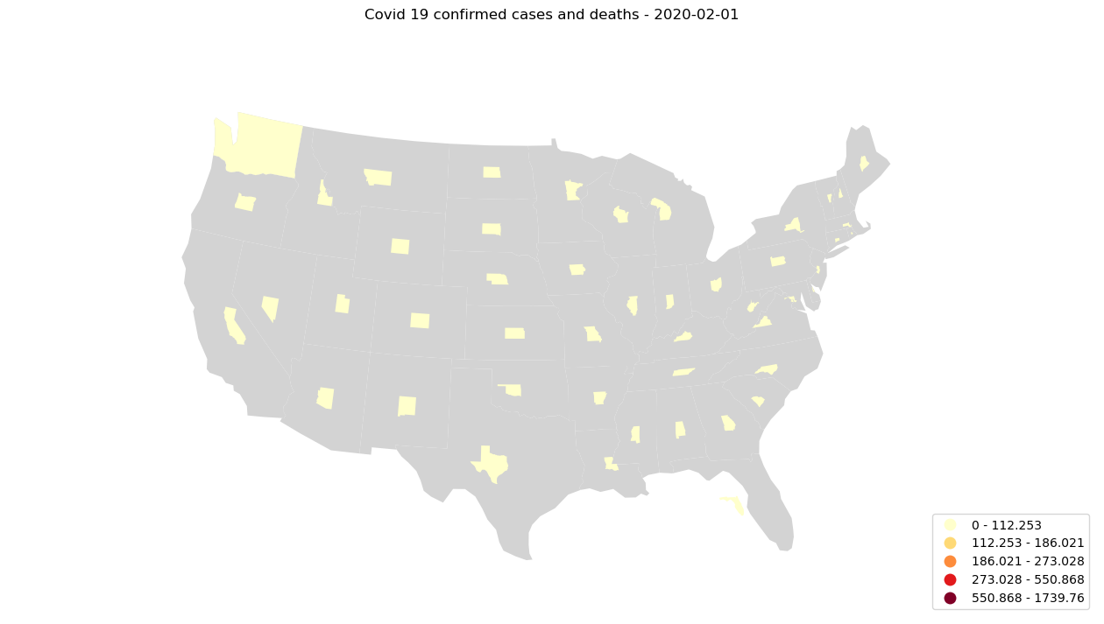

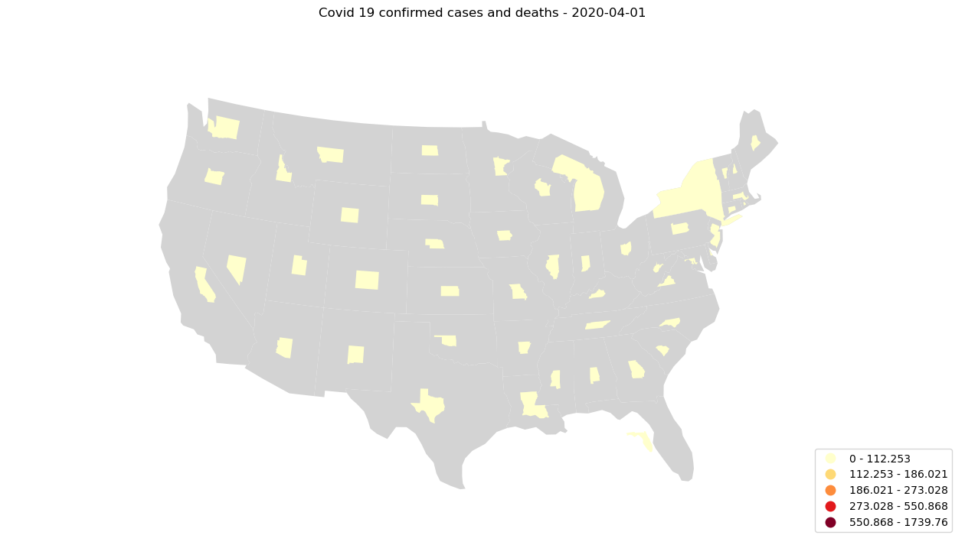
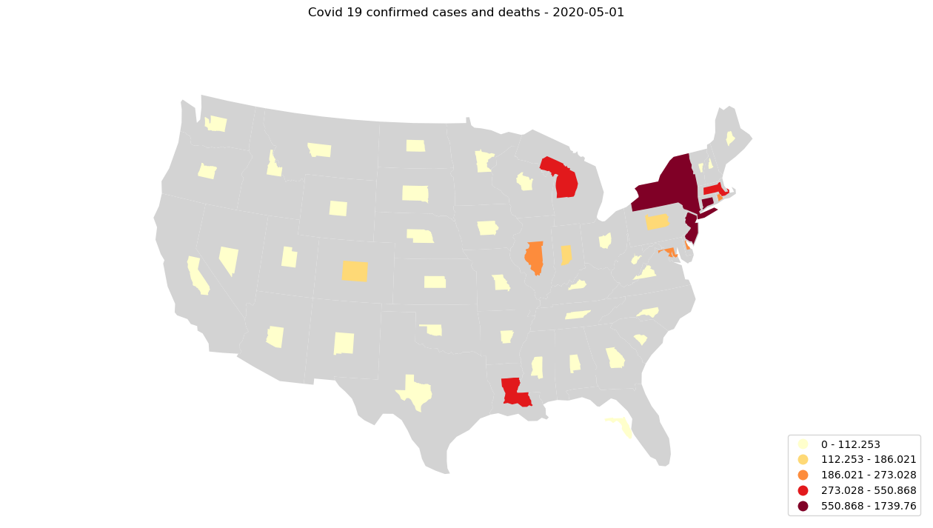
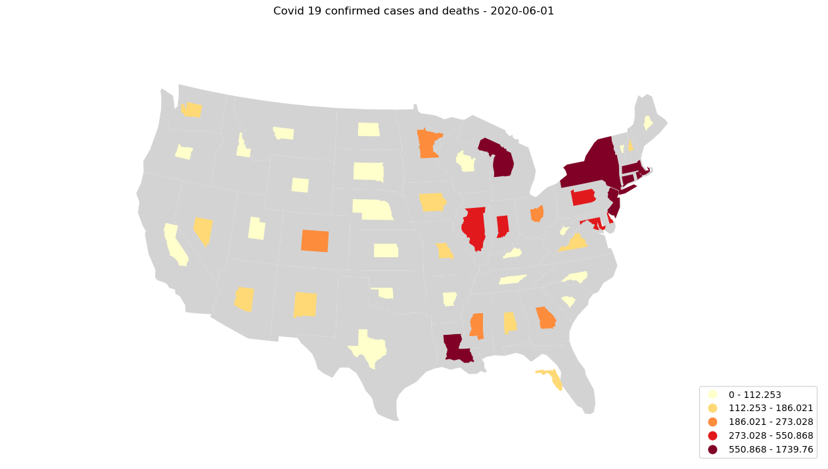
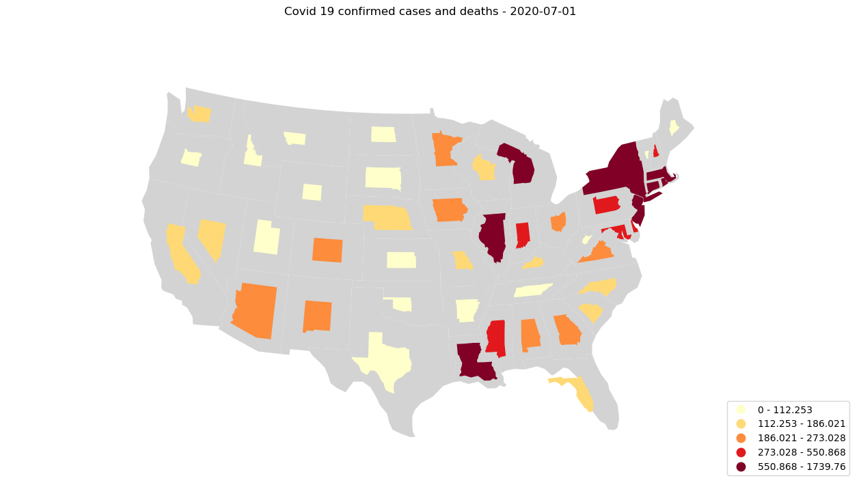
Photo caption can be entered here to the desired length. Tell people about the historical significance of the image or point out relevant pieces of information.
Photo credit here

Slide 25


Slide 26
Methods & Results: Contiguous Cartogram univariate
preserves topology of the underlying regions at the cost of distorting the shape.
we use a diffusion based density equalizing cartogram - Michael Gastner
we made 2 contributions to open source C repo

Slide 27
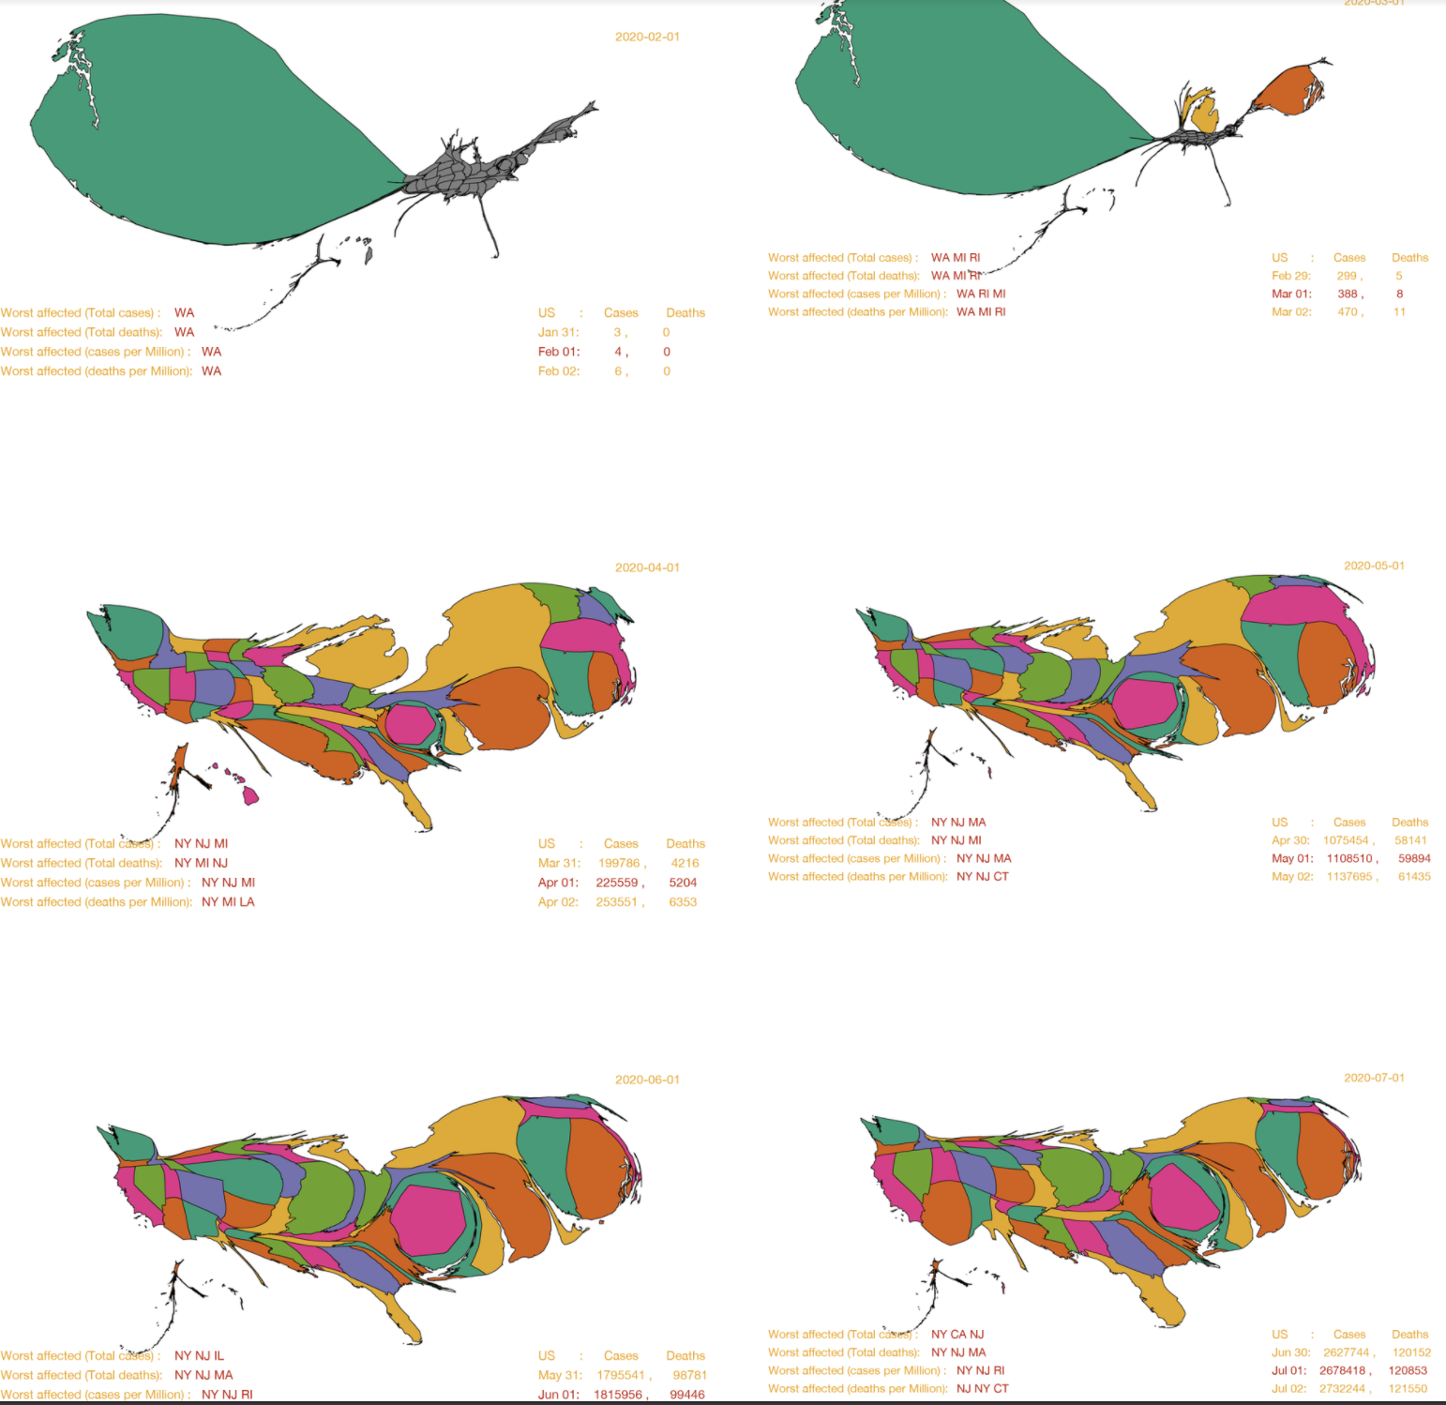

Slide 28
Methods & Results: Contiguous Cartogram univariate
early March - Washington, Michigan and Rhode Island register cases
cartogram very clearly depicts this so nicely by dedicating the entire land region of US to draw these states with positive cases.
as the time series progresses, by the beginning of April, the pandemic has spread to all the states of the US
the cartogram depicts this perfectly as the land region of the US is distributed across all the states, in proportion to the number of cases they have per Million.
it is also obvious that Washington that registered the first cases, has its cases well under control by this time

Slide 29
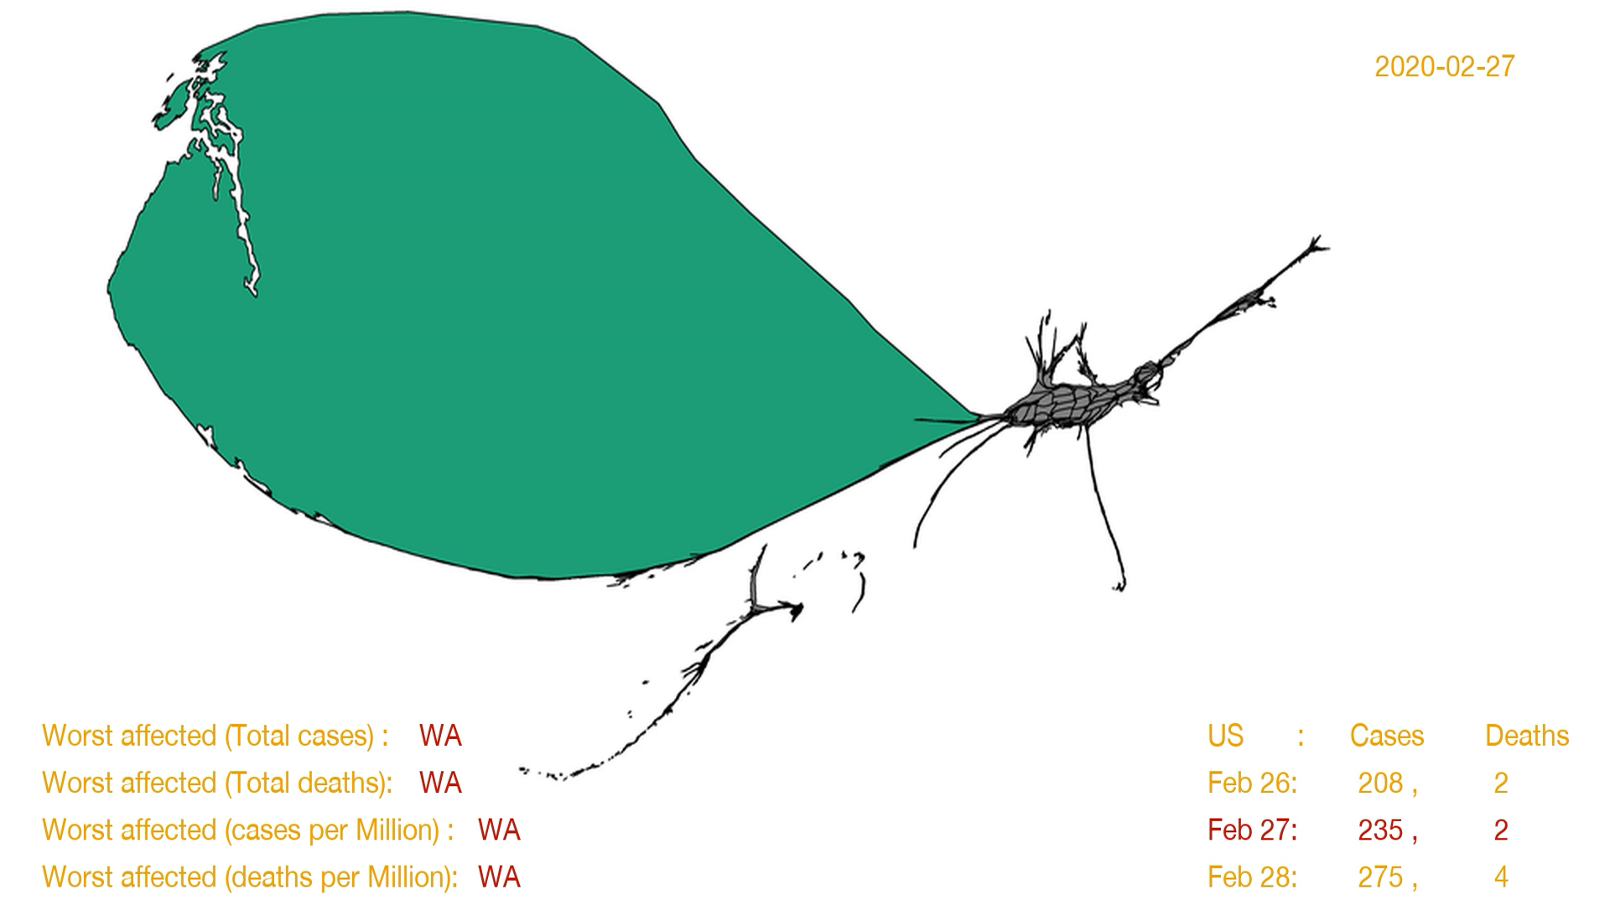

Slide 30
Methods & Results: Contiguous Cartogram bivariate
the final idea in our visualization series – use both cases deaths using a contiguous cartogram technique.
everything remains the same except the color scheme.
color is assigned based on the number of deaths per million

Slide 31
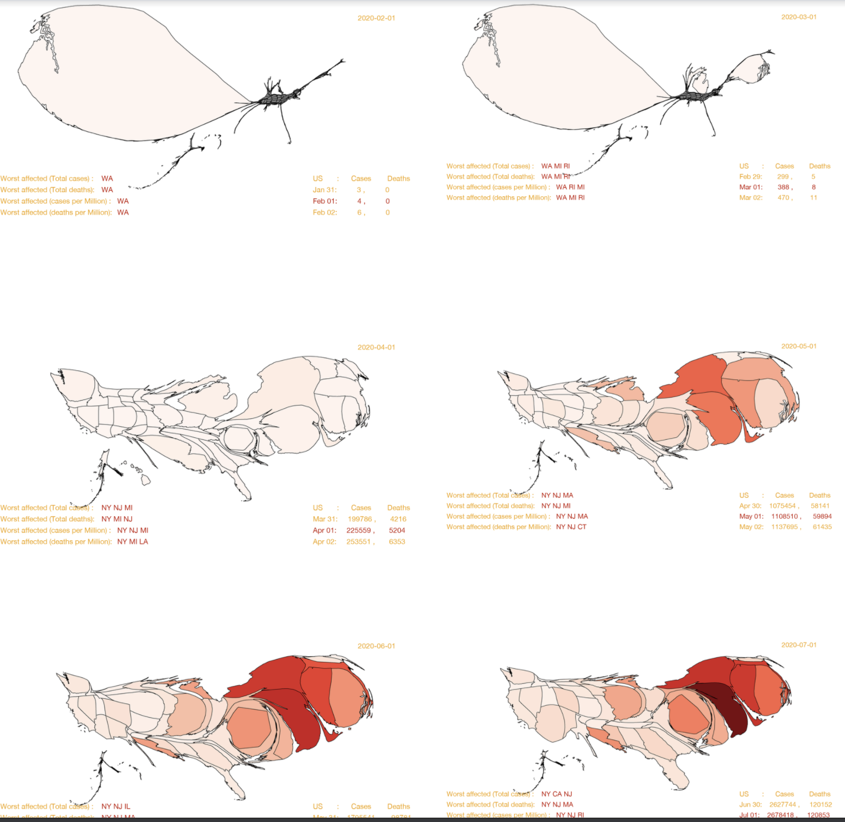

Slide 32
Methods & Results: Contiguous Cartogram bivariate
until the beginning of April - deaths - relatively low in few hundreds
by April, deaths increase closer to 5k, spread all over the country - visible in the light red hue spread across the country.
big increase in deaths - in April - as we see in the transition from April to May, we can observe NY, NJ and CT becoming darker and the deaths have ballooned up by 10x.
as observed in cases, East dominates the map w.r.t deaths & the cartograms also depict the rise of New Jersey in dominating the number of deaths in the last 3 months.

Slide 33
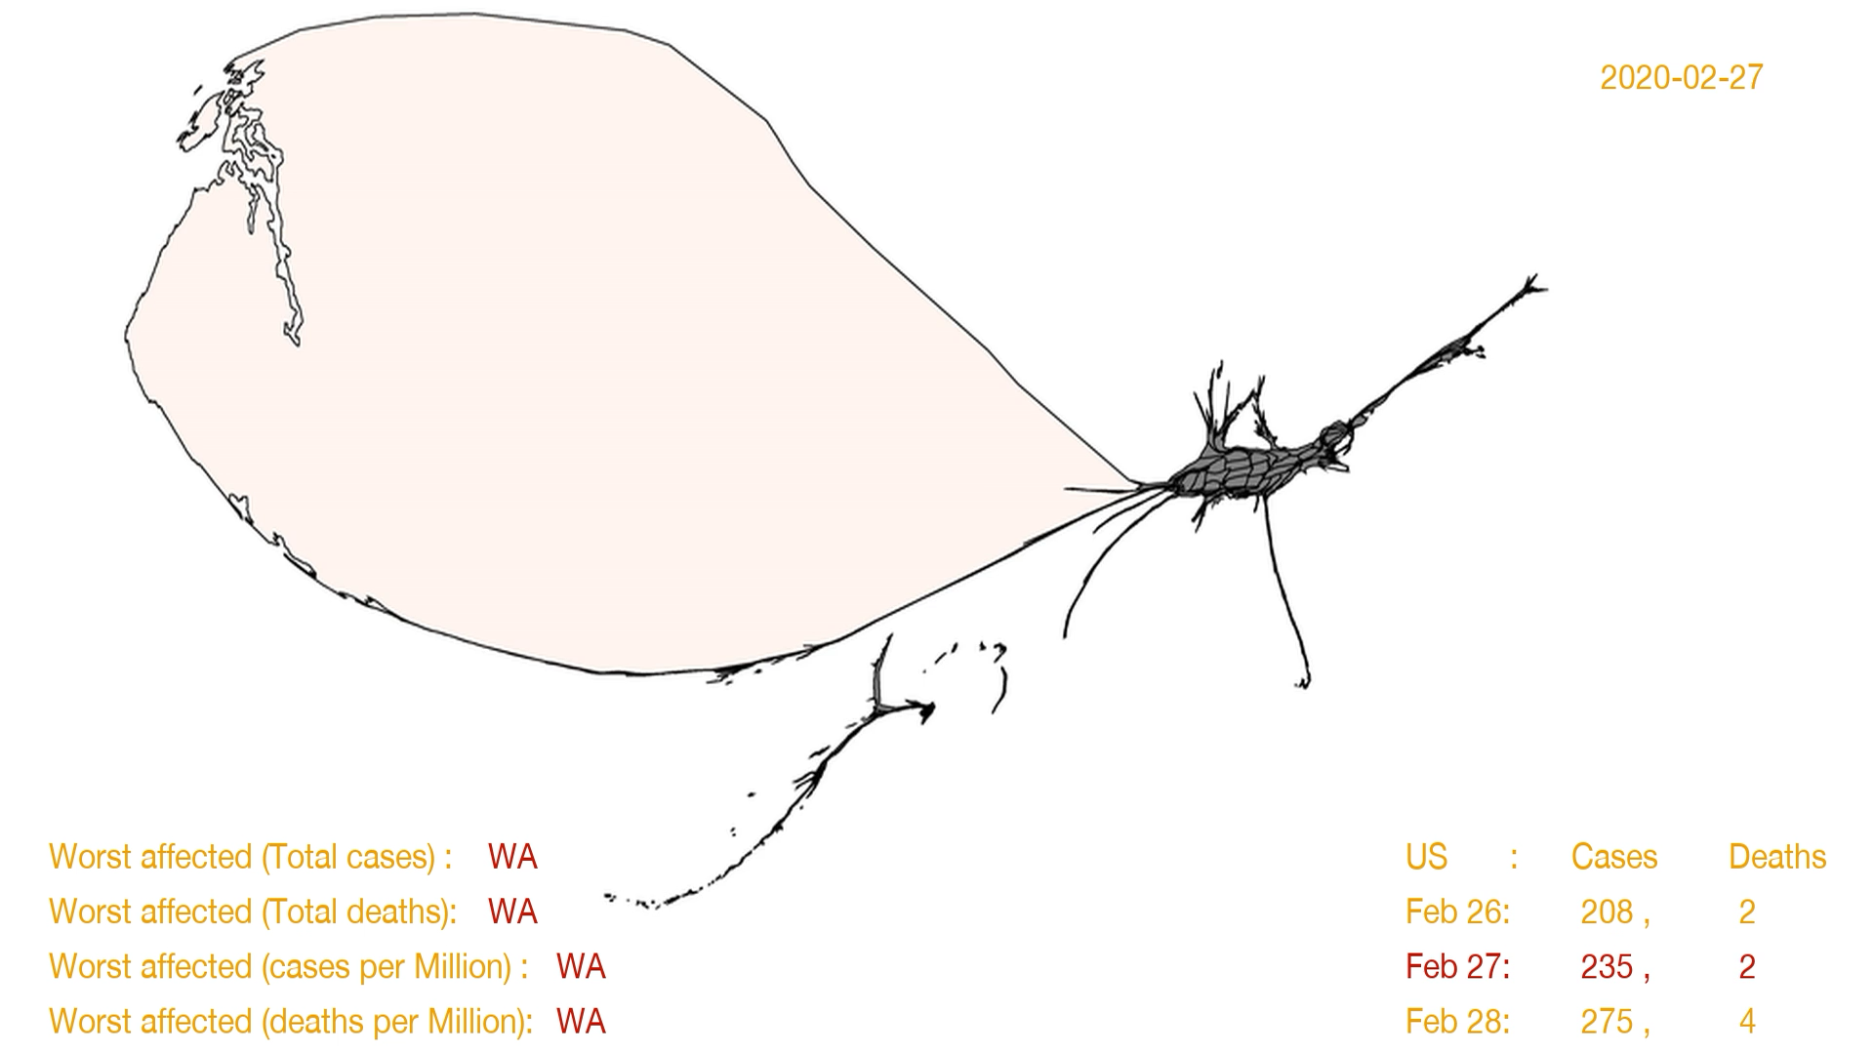

Slide 34
Conclusion and Future Work

Slide 35
Conclusion
choropleth approach - two main misgivings,
one to do with displaying cases and deaths simultaneously
the natural flow of the time lapse video.
noncontiguous cartograms
visualizations and time lapsed video - number of cases and deaths
only drawback with noncontiguous nature in time lapsed animation.
density equalizing cartograms
first series focusing only on cases - stunning set of visualizations & time lapsed animation,
second series using sequential colors for deaths as well, thereby resulting in visuals and time lapsed video neatly portraying the cases and deaths.
one drawback of the cartogram approaches - distortion in shape, harder to distinguish regions

Slide 36
Future Work
failed experiment - to find the intermediate frames given two frames at t1 and t2.
more work - underlying cartogram program itself to display the state names in the visuals or other approaches - easy on the viewers to identify the regions.

Slide 37
Thank You

